Slide 1
TypeScript:
Superheroic Power In Angular
2016.12
Radoslav Kirov
Zhengbo Li

Slide 2
Outline
Why TypeScript?
Getting Started with TypeScript + Angular

Slide 3
Why TypeScript?
Section II
Section III
Why TypeScript
What issue are we solving?

Slide 4
Big JavaScript apps are hard.

Slide 5
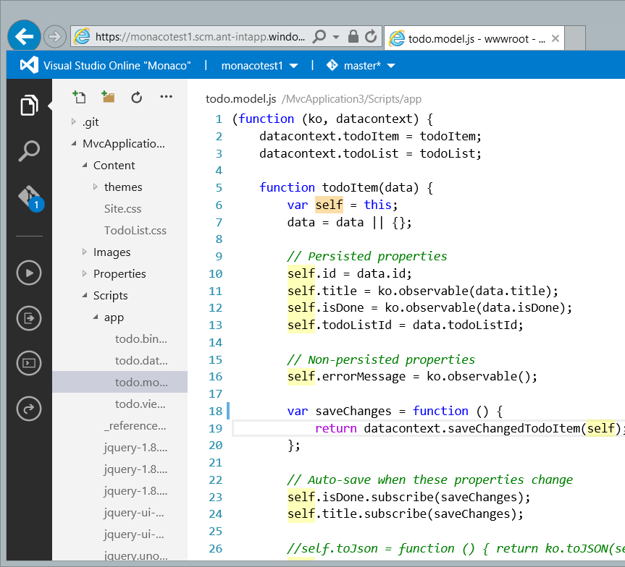
Monaco (Visual Studio Code)
Million lines of JavaScript code

Slide 6
JavaScript alone is not enough.

Slide 7
The Feature Gap
ES2015
ES2016
ES2017
ES2018
ES3
ES5
JavaScript Evolution
State of web JS
State of server JS
State of the art JS
Target
Productivity
JavaScript feature gap
June 2016
Dec 2016

Slide 8
TypeScript:
A typed superset of JavaScript that compiles to plain JavaScript

Slide 9
Any browser. Any host. Any OS.
Open Source.

Slide 10
The TypeScript Language
Types
JavaScript
TypeScript Compiler
JavaScript

Slide 11
Demo:
JavaScript to TypeScript

Slide 12
Outline
Demo Recap
Benefits from TypeScript today
Compile time type checking
Consume JavaScript file with --allowJs
Opt-in gradual type system
Use future JavaScript feature now

Slide 13
JavaScript IS TypeScript

Slide 14
Downlevel Compilation
ES6
TypeScript Compiler
JavaScript
(ES5)
TS
ES5

Slide 15
JavaScript IS TypeScript
ES7
TypeScript
ES6
ES6+
ES5
ES5

Slide 16
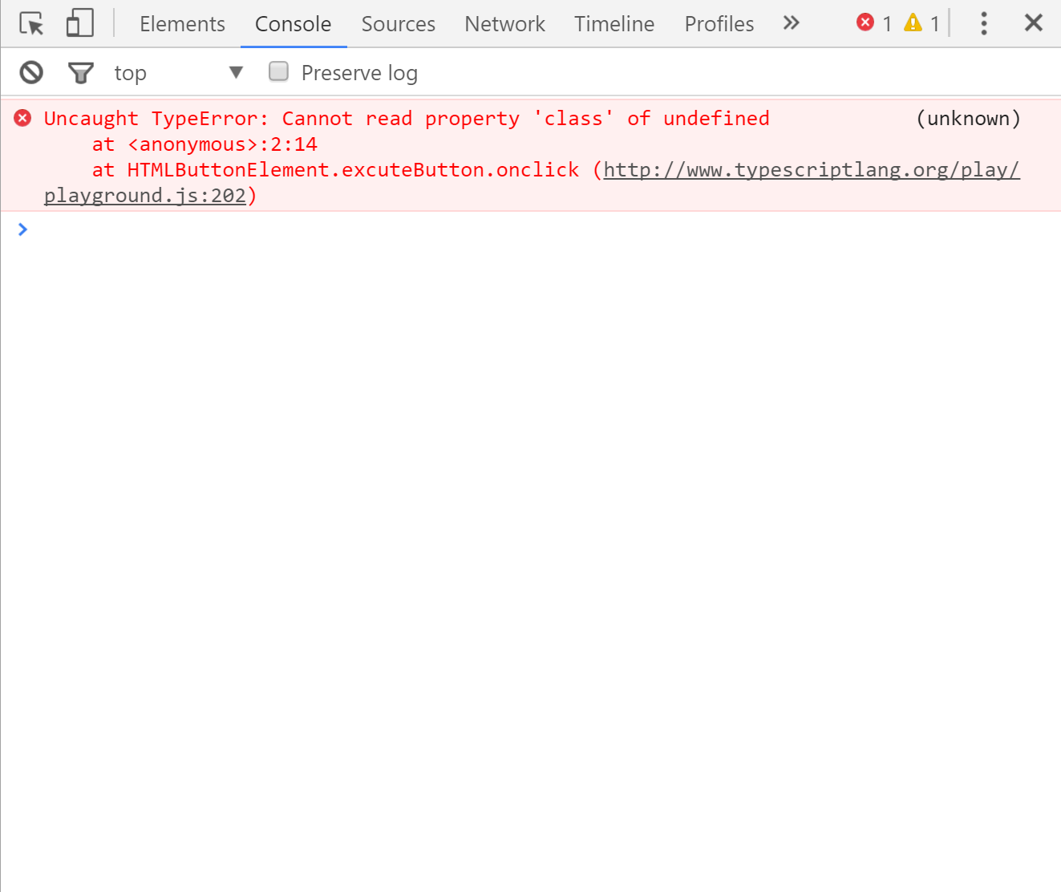
JavaScript’s Billion Dollar Mistake

Slide 17
Demo:
Type checking in action

Slide 18
Outline
Demo Recap
Type Checking in Action
Managing nullability in JS is error-prone
Non-nullable types provide null/undefined coverage
Control flow analysis traces flow for you

Slide 19
Getting Started with TypeScript + Angular
Section II
Section III
Why TypeScript
What issue are we solving?

Slide 20

❤
TS

Slide 21


❤
TS

Slide 22
Demo:
Migration from Angular 1

Slide 23
Angular 2 and TypeScript
Section II
Section III
Why TypeScript
What issue are we solving?
Notes:
migration tools,

Slide 24
Angular 2 ergonomics are great with TypeScript
Notes:
While Angular1 works great with TypeScript, it was built before TS existed.
Ng2 was build with TS in mind (and internally built with TypeScript), which means we ensured the ergonomics are great
A number of features in TS (decorators, runtime types for injection) make the framework experience seamless.

Slide 25
Demo:
Angular 2 and TypeScript

Slide 26
Outline
Demo Recap
Angular 2 + TypeScript
ES6 features make code more readable
Decorators separate framework from user code
Dependency injection makes use of types

Slide 27
Using 3rd Party Libraries?
@types
Typings
Evolution of Type Acquisition
TSD
DT to npm
publish tool
Definitely
Typed
.d.ts registry and
acquisition tool
Tool for fetching
.d.ts files from DT
Repository for
type declarations
npm install -S @types/lodash

Slide 28
Demo:
Type acquisition

Slide 29
Outline
Demo Recap
Type Acquisition
npm is all you need
Contribute to DefinitelyTyped!

Slide 30








TypeScript Editors
Visual Studio
Sublime Text
Atom
WebStorm
Visual Studio Code
Eclipse
Emacs
Vim

Slide 31
Four Releases in One Year
2.0
1.8
1.7
Null-nullable types Control flow analysis Readonly properties `this` type in functions type acquisition
…
1.6
JavaScript in TS projects + control flow analysis
Async/await on server + polymorphic ‘this’ types
Full ES2015 + React/JSX

Slide 32
Advanced TypeScript
Section II
Section III
Why TypeScript
What issue are we solving?

Slide 33
TypeScript has powerful type features

Slide 34
Demo:
Advanced TypeScript

Slide 35
Outline
Demo Recap
Advanced TypeScript
async / await for handling promises
Mapped types for all your dynamic JS patterns

Slide 36
In Review: Session Takeaways
Why TypeScript?
Getting started with TypeScript is easier than ever
TypeScript and Angular together is awesome
The Future

Slide 37
Get in touch!
We’re on GitHub! (https://github.com/Microsoft/TypeScript)
And Twitter! (@typescriptlang)
And Gitter! (https://gitter.im/Microsoft/TypeScript)
Demo code will be posted at https://github.com/zhengbli/ng-china-2016

